Slide 1
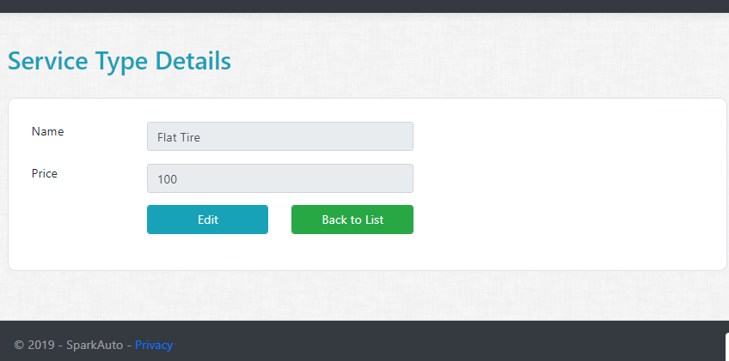
Assignment 1
Service Type Details Razor Page
Create Details Get Handler for Service Type.
Create Details Razor page (UI) for Service Type.
All fields should be disabled or read only

Slide 2
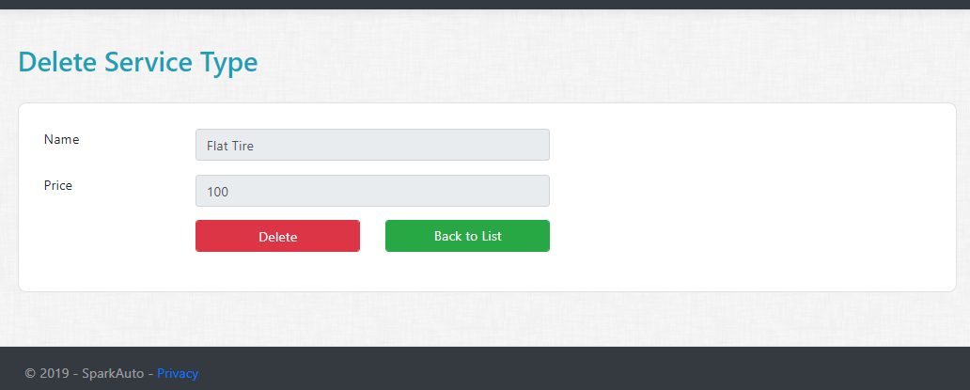
Assignment 2
Service Type Delete Razor Page
Create Delete Get and Post Handler for Service Type.
Create Delete Razor Page (UI) for Service Type.
All fields should be disabled or read only

